Slide 1

New Jersey Department of Community Affairs Neighborhood Revitalization Tax Credit Program
Ducktown Revitalization Economic Development Corporation Atlantic County Economic Alliance

Slide 2


Agenda
Introductions/Welcome
NRTC Program Updates
Key Dates
Short Forms/Tax Credit Application
Confirm Participation/Commitment
ACEA Assistance Hotline

Slide 3
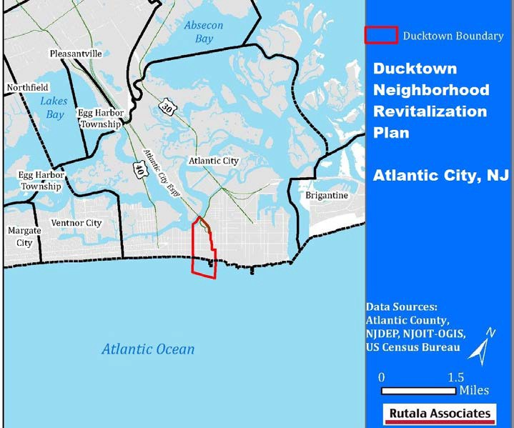
Neighborhood Revitalization Tax Credit Program
Why participate?
The Atlantic County Economic Alliance, a private non-profit economic development group has volunteered to bring its business, economic development, and redevelopment experience to the Ducktown Neighborhood of Atlantic City to assist that area by “pulling itself up by its bootstraps.”
The ACEA has a record of making a difference in Atlantic County. We want to bring this drive and experience to a small part of Atlantic City and demonstrate that meaningful change is possible.
We need your help to finance this program to initiate economic change in the Ducktown neighborhood.

Slide 4

Program Outline
A for profit company may contribute to a qualified neighborhood in New Jersey and receive a $1 for $1 tax credit in the year of the contribution (Tax Year 2021)
Contributions may be made from $25,000 to
$1,000,000
Tax credit is issued for corporate business tax, public utilities excise tax, gross income tax, insurance premium tax and public utilities franchise tax
Must pick at least 3 neighborhoods in order of priority
Must fill out the four page “Neighborhood Revitalization Tax Credit Program Business Entity Application”

Slide 5
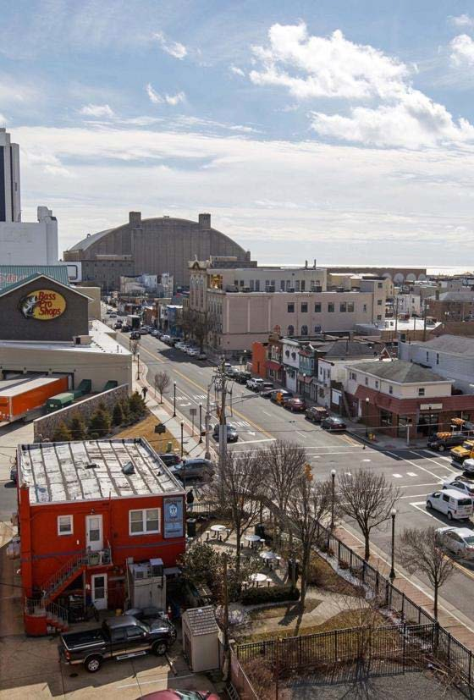
Program Outline
On November 22nd, the NJDCA will advertise the eligible neighborhoods and businesses make their contributions
Interested business must submit their “Neighborhood Revitalization Tax Credit Program Business Entity Application” as soon as possible!!!
A minimum of three neighborhoods, and a maximum of ten neighborhoods will be listed in order of priority
Send no money at this time!

Slide 6
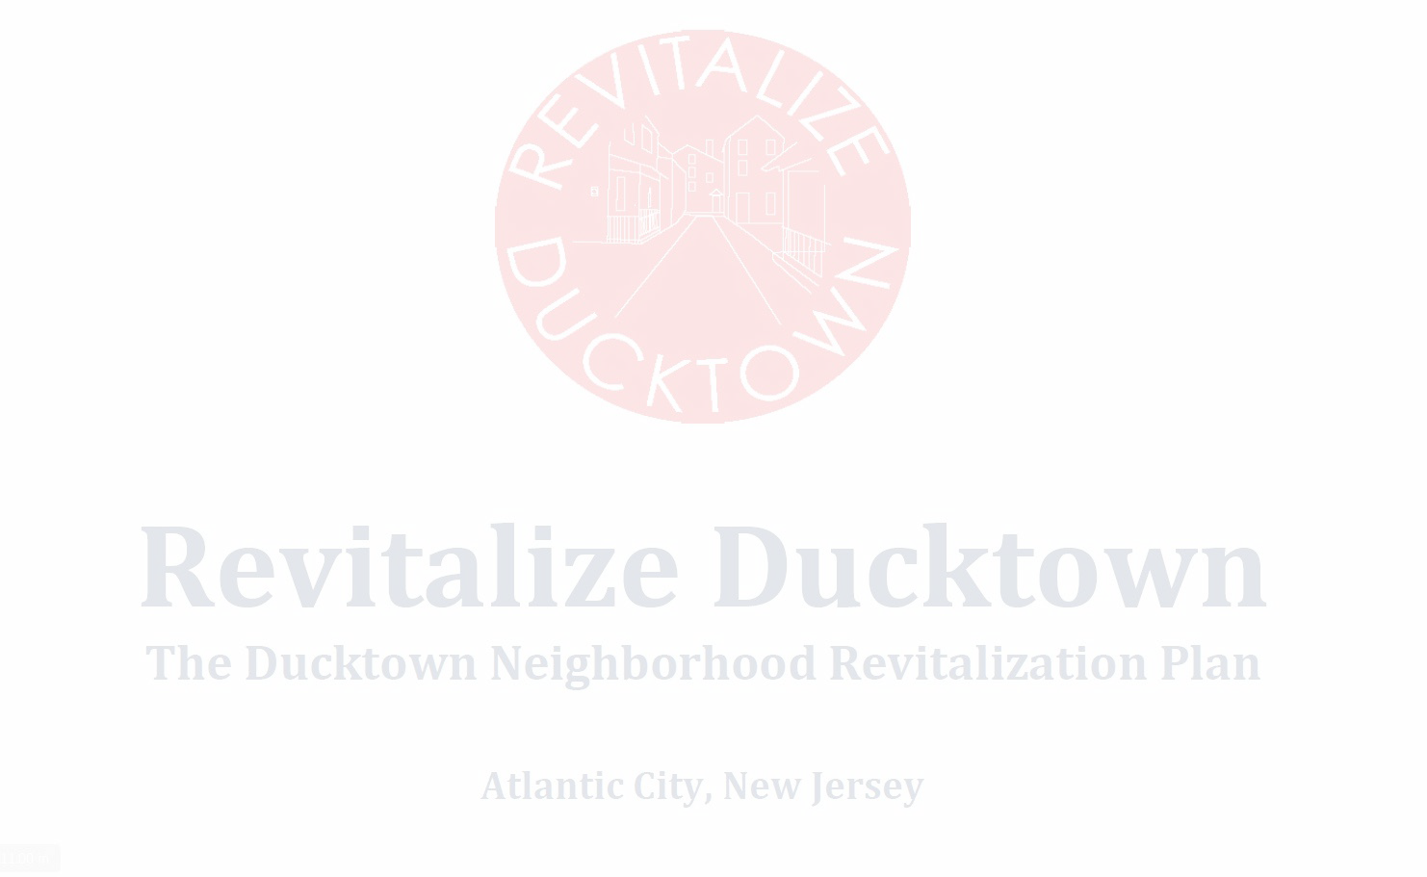
Program Outline
December 15 is the last day for New Jersey Department of Community Affairs to receive the “Neighborhood Revitalization Tax Credit Program Business Entity Application”
Before the end of the year, NJDCA will determine which neighborhood projects will be funded, and which business contributions will be accepted
If the business contribution is accepted by NJDCA, the business will be informed, and the contribution check must be sent overnight by the business to the NJDCA
The NJDCA will issue a tax certificate form that will provide a dollar-for-dollar credit against the following taxes though only one tax can be selected
  Corporate business tax
  Public utilities excise tax
  Gross income tax
  Insurance premium tax
  Public utilities franchise tax
The tax credit must be used in totality in the year the contribution is made, and tax credit is issued. Unused tax credits may not be used in any other year.
(Ref: https://www.nj.gov/dca/divisions/dhcr/offices/docs/nrtc/guide_doc_for_business_entities.pdf)

Slide 7
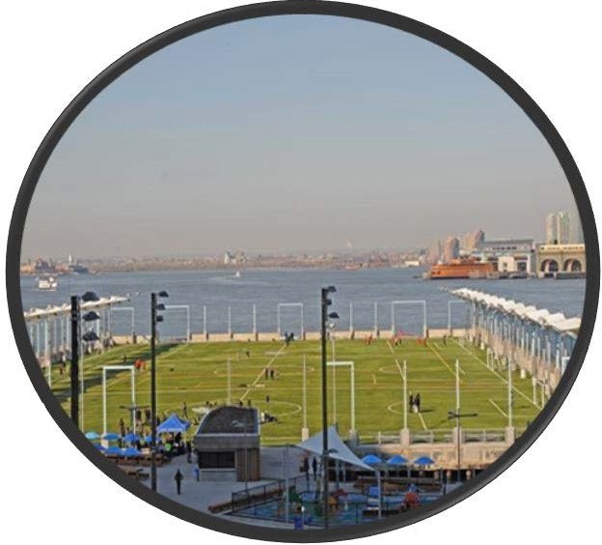
Proposed Activities
Revitalize Ducktown includes many community endorsed objectives that have been identified as critical for improving outcomes for neighborhood
residents. Measurable outcomes are associated with each activity and are presented herein. All the activities proposed are included in the approved plan.
Abandoned/Foreclosed Property Rehabilitations (Joint project with Atlantic County Improvement Authority) Implementation activities A.4; A.7; J.3a; J.3h
Façade improvement program. Implementation Activity A.6
Trash Abatement. Implementation Activity A.9
Placemaking enhancements. Implementation activity B.7
Seed funding for new enterprises. Implementation activity G.1a
Mutual aid program set-up. Implementation activity J.1b
Adult education/GED classes sponsorship. Implementation activity J.2b
Workforce training/immigration assistance. Implementation activity J.1d; J.2c

Slide 8
Ducktown NRTC Budget 2021
Uses: |  |  | NRTC |  | Other |  | Total
Housing & Economic Development
Abandoned Housing |  |  | $ 120,000.00 |  | $ 120,000.00 |  | $ 240,000.00 |  | 3 homes - 50% NRTC & 50% Luxury Tax (hard & soft cost)
Housing Rehabilitation |  |  | $ 125,000.00 |  | $ 125,000.00 |  | $ 250,000.00 |  | Five homes - Leveraging ACIA or CDBG Programs
Commercial Façade Improvements |  |  | $ 60,000.00 |  | $ 60,000.00 |  | $ 120,000.00 |  | Twelve businesses -50% NRTC, 50% Owner
Workforce Training & Small Business Recovery |  |  | $ 15,000.00 |  | $ - |  | $ 15,000.00 |  | Leveraging ACCC, B&GC Programs
Microenterprises |  |  | $ 10,000.00 |  | $ - |  | $ 10,000.00 |  | Leveraging ACEA Experience
Home Buyer Assistance |  |  | $ 12,500.00 |  | $ 287,500.00 |  | $ 300,000.00 |  | Leveraging AtlantiCare Foundation, CDBG, ACIA
Childcare Training & Certifications |  |  | $ 5,000.00 |  |  |  | $ 5,000.00 |  | Leveraging services offered by American Red Cross
Youth Employment |  |  | $ 5,000.00 |  |  |  | $ 5,000.00 |  | Leveraging programs provided by Boys & Girls Club
Subtotal | 68% |  | $ 352,500.00 |  | $ 592,500.00 |  | $ 945,000.00
Complimentary Activities
Multi-Cultural Summer Camp |  |  | $ 2,500.00 |  | $ 5,000.00 |  | $ 7,500.00 |  | Leveraging Atlantic City Mayor Small's Initiative
Organizing & Supporting Events/Tours |  |  | $ 5,000.00 |  | $ - |  | $ 5,000.00 |  | Leveraging Support from AtlantiCare and ACCC
Build on the Ducktown Arts District |  |  | $ 10,000.00 |  | $ 10,000.00 |  | $ 20,000.00 |  | Leveraging Stockton, Mudgirls, ACAF involvement
Ducktown CDC Capacity Building |  |  | $ 5,000.00 |  | $ 2,000.00 |  | $ 7,000.00 |  | Leveraging ACCF Grant
Microgrants for Neighborhood Projects |  |  | $ 8,000.00 |  | $ - |  | $ 8,000.00 |  | Leveraging support from AtlantiCare, ACSID
Ducktown Marketing Campaign |  |  | $ 8,000.00 |  |  |  | $ 8,000.00 |  | Leveraging MeetAC Marketing Campaign
Grants & Planning Services |  |  | $ 25,000.00 |  | $ - |  | $ 25,000.00 |  | Consultant Services
Neighborhood Ambassadors |  |  | $ 15,000.00 |  |  |  | $ 15,000.00 |  | Leveraging CRDA - SID services
Subtotal | 15% |  | $ 78,500.00 |  | $ 17,000.00 |  | $ 95,500.00
Total |  |  | $ 431,000.00 |  | $ 609,500.00 |  | $ 1,040,500.00
Administration/Personnel
ACEA Administration | 8% |  | $ 40,000.00 |  | $ 36,000.00 |  | $ 76,000.00
Ducktown CDC Community Outreach Coor. | 10% |  | $ 50,000.00 |  | $ - |  | $ 50,000.00
Subtotal |  |  | $ 90,000.00 |  | $ 36,000.00 |  | $ 126,000.00
 |  |  | $ 521,000.00 |  | $ 645,500.00 |  | $ 1,166,500.00
Maximum Grant | 100% |  | $ 521,000.00

Slide 9



Key Business Contribution Dates
November 22, 2021 – Businesses Submit Contribution Applications
  Applications need to be submitted as soon as possible!
  First come, first served until credits are fully funded
By December 31, 2021 – DCA will determine which neighborhood projects will be funded & which business contributions will be accepted
  If the business contribution is accepted by NJDCA, the business will be informed, and the contribution check must be sent overnight by the business to the NJDCA

Slide 10
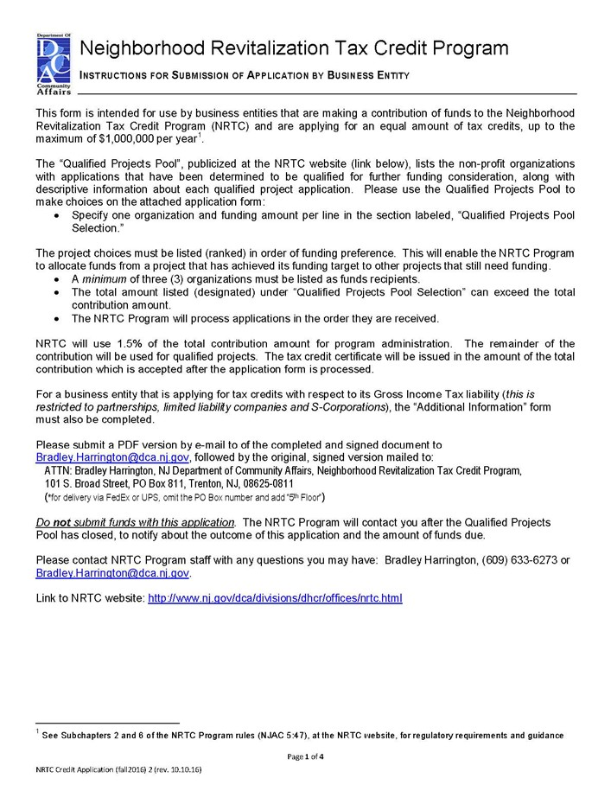
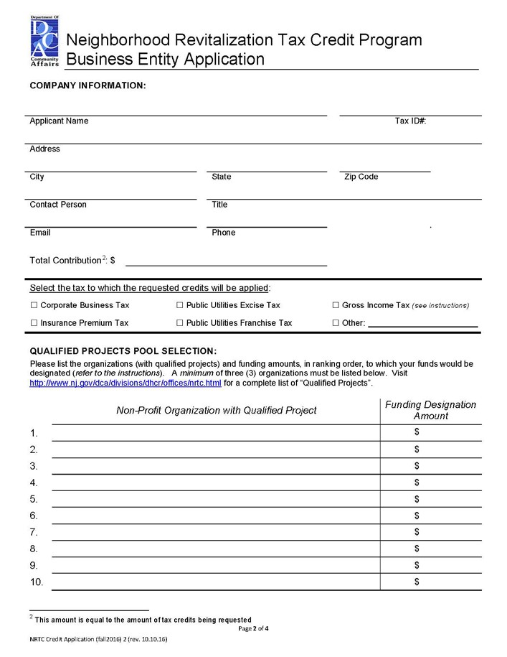

Slide 11
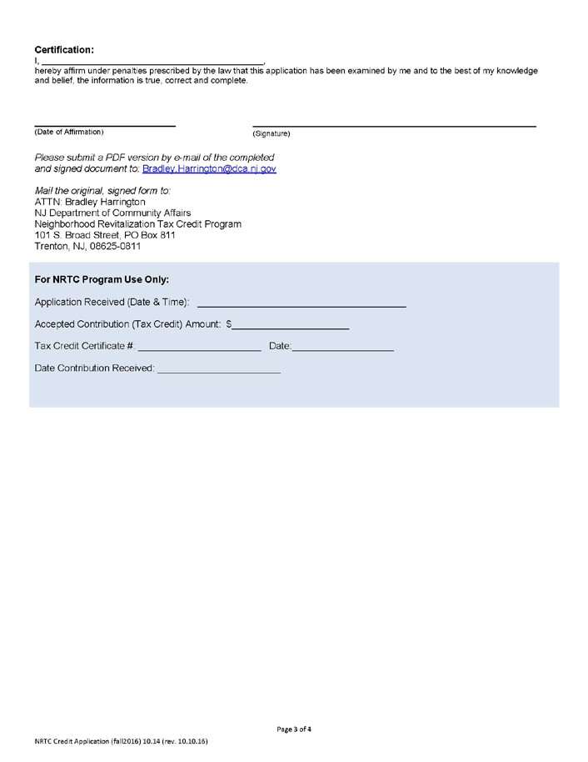
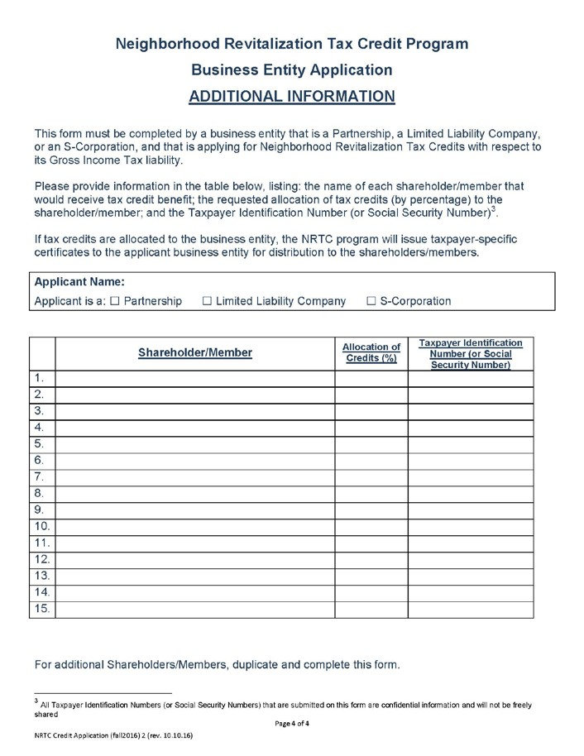

Slide 12

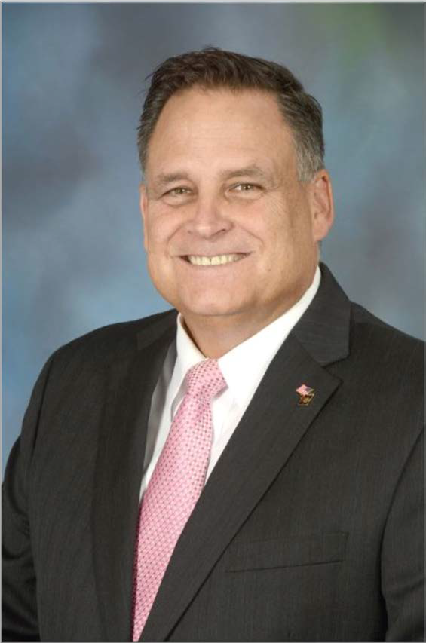
Assistance Hotline
Max Slusher
Director of Business Development
Atlantic County Economic Alliance 600 Aviation Research Boulevard Suite 120
Egg Harbor Township, NJ 08234
609-335-2869
MSlusher@aceanj.com

Slide 13
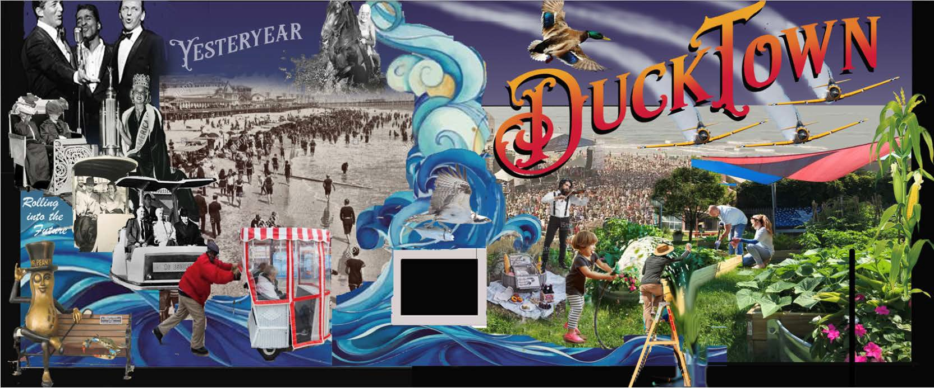


Thank you for your support!

